Slide 1
Alcohol Misuse in New Mexico Prevalence of Heavy Drinking and Alcohol Liver Disease
Tim Werwath, Coop Consulting, Inc.

Slide 2
Overview
Alcohol consumption is high in the United States, but far below other countries such as Australia and France.
Many countries with higher consumption have a lower prevalence of alcohol use disorder.
14.8 million Americans 18 and older have an alcohol use disorder (6.1%)
155,000 New Mexicans 18 and older have an alcohol use disorder (7.4%)
Sources: World Health Organization; 2015-2016 National Survey of Drug Use and Health

Slide 3
Definitions
Alcohol use disorder (AUD) is characterized by:
Patterns of drinking at high risk for developing an AUD:
Binge drinking – Drinking that brings BAC to levels above 0.08 - typically 5 or more drinks for men, 4 or more drink for women
Heavy drinking – Drinking more than 3 drinks on a single day or 7 drinks per week for women, 4 drinks on a single day or 14 drinks per week for men
Source: National Institute on Alcohol Abuse and Alcoholism
Increased tolerance Withdrawal symptoms Continued use despite problems | Inability to fulfill roles Neglect of activities Increased time spent drinking Inability to cut down

Slide 4
Risk Factors for Heavy Drinking
Men have higher rates than women (6.3% vs. 5.5%)
Rates are highest among those 18-24 (6.7%)
Steadily decline with age and dramatically decline after age 64
People who are married have lower rates
5.4% vs. 7.3% for those never married and 5.7% for those divorced
Source: Center for Disease Control and Prevention, 2016 Behavioral Risk Factor Surveillance System

Slide 5
Risk Factors for Heavy Drinking
People who are employed have higher rates
7.0% vs. 5.6% for those unemployed and 3.3% for those unable to work
Rates are highest among those making $75,000 or more
Steadily decline with lower levels of income
People with a college degree have higher rates
6.1% vs. 4.9% for those without a high school degree
Source: Center for Disease Control and Prevention, 2016 Behavioral Risk Factor Surveillance System

Slide 6
Risk Factors for Heavy Drinking
Family history of alcoholism – especially if paired with childhood family violence and parental antisocial behavior
Anxiety and/or depression – especially among those with a coping style of avoidance rather than confrontation
Explicit attitudes towards alcohol (i.e., “drinking to blow off steam”)

Slide 7
Prevalence of Heavy Drinking in NM
Rates of heavy drinking rose in the early 2000s but then declined and have been relatively constant since 2005
Rates are higher in New Mexico among:
Individuals 25-44 (compared to 18-24 nationally)
American Indian and Hispanic males
Black and White females

Slide 8
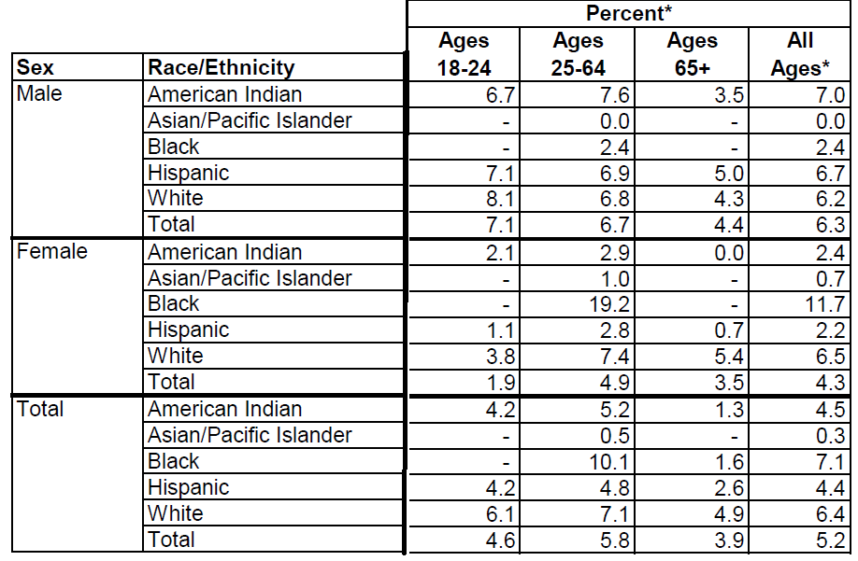
Prevalence of heavy drinking among adults 18 and older in New Mexico by age, race/ethnicity, and gender, 2014-2016
Source: New Mexico Department of Health, Epidemiology and Response Division

Slide 9
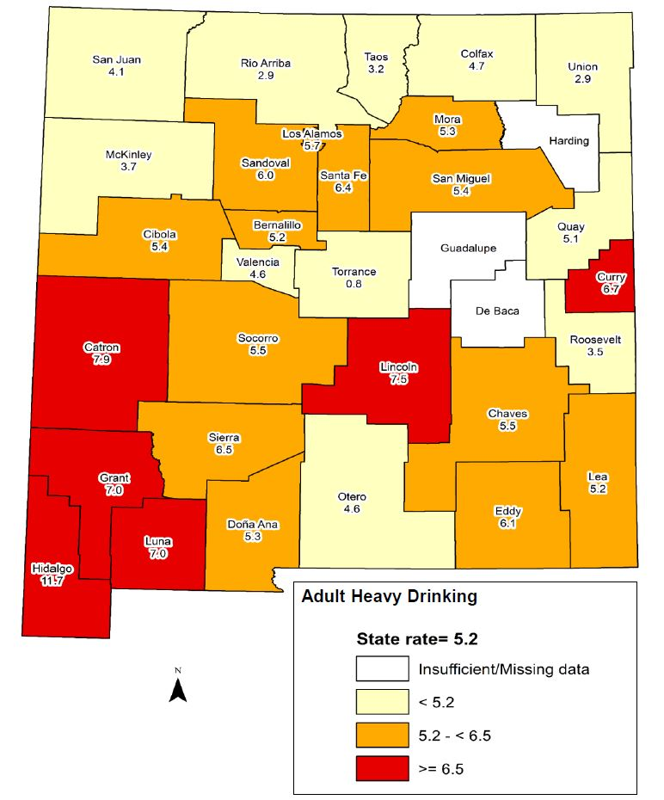
Prevalence of heavy drinking among adults 18 and older in New Mexico by county, 2014-2016
Source: New Mexico Department of Health, Epidemiology and Response Division

Slide 10
Consequences of Heavy Drinking
The leading cause of death from excessive alcohol use is alcoholic liver disease
The greater the amount and longer the duration of heavy drinking, the more likely the disease will develop
On average, having six or more drinks per day will lead to cirrhosis of the liver in 10 years for men and 5 years for women¹
The amount of alcohol that leads to liver damage is extremely variable from person to person
¹American College of Gastroenterology, Alcoholic Liver Disease: A Consumer Health Guide

Slide 11
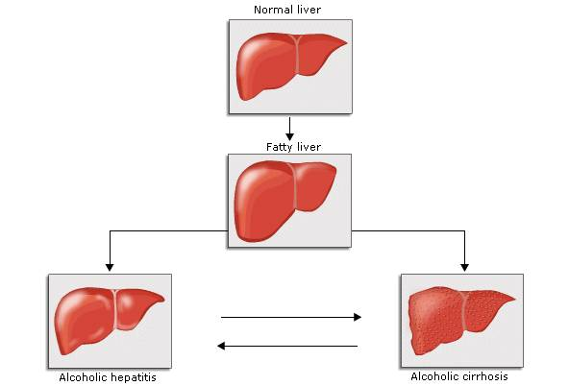
Alcoholic Liver Disease (ALD)
Fat accumulation in liver cells from the metabolism of alcohol
Inflammation of the liver, a reaction to fatty deposits in liver cells
The replacement of normal liver tissue by scar tissue due to repeated injury

Slide 12
Risk Factors for ALD
Women are at a greater risk for ALD at lower quantities of alcohol than men, even accounting for body size
Genetic factors influencing the production of liver enzymes involved in metabolism
Drinking outside of meal times increases the risk of ALD by nearly three times
Source: Mayo Clinic, Pathogenesis, Diagnosis, and Treatment of Alcoholic Liver Disease

Slide 13
Diagnosis of ALD
In the early stages, ALD exhibits subtle and often no abnormal physical findings
Symptoms of advanced ALD include yellowing of the skin and eyes (jaundice), altered consciousness, and increased belly size due to fluid accumulation
The progression of ALD to liver cirrhosis is mostly irreversible - liver transplantation is the only definitive treatment option
Source: Mayo Clinic, Pathogenesis, Diagnosis, and Treatment of Alcoholic Liver Disease

Slide 14
Deaths from ALD are Increasing
Nationwide, ALD is the 12th leading cause of death (37,890 deaths in 2013)
The death rate from ALD increased by 18.6% between 2000 and 2013
Rates increased the most for white males (19%) and females (50%), and individuals aged 25-34 (55%)
Source: Yoon, Y. H., C. M. Chen, and H. Y. Yi. "Liver cirrhosis mortality in the United States: National, State, and Regional Trends, 2000-2013." NIAAA Surveillance Report #105, 2016

Slide 15
Deaths from ALD are Increasing
All Alcohol-Related Deaths Per 100,000 Population, New Mexico and the United States
Source: New Mexico Department of Health, Epidemiology and Response Division

Slide 16
Deaths from ALD are Increasing
Alcohol-Related Deaths Per 100,000 Population, New Mexico, by Type
Source: New Mexico Department of Health, Epidemiology and Response Division

Slide 17
Prevalence of ALD death in New Mexico
ALD accounts for about a quarter of all alcohol-related causes of death in New Mexico
Rates of ALD death are nearly twice as high among men compared to women (25.5 per 100,000 compared to 13.3)
Rates of ALD death are highest among Native American and Hispanic males, and Native American females

Slide 18
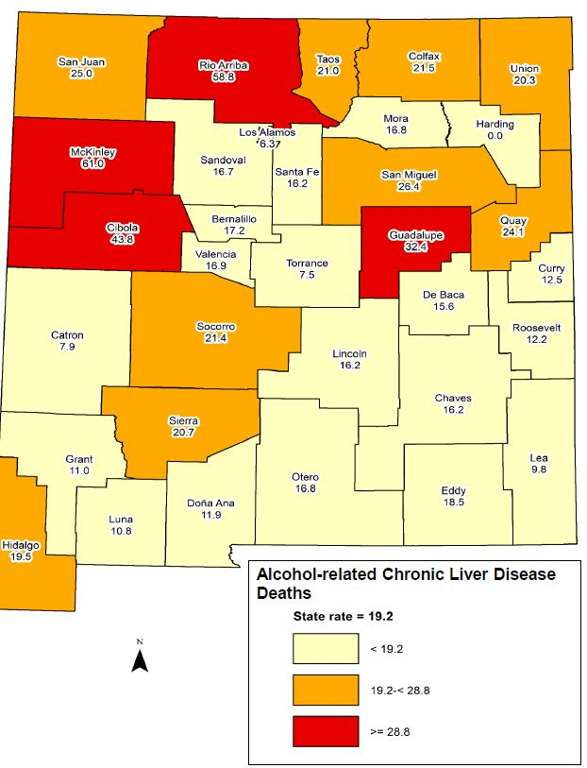
Prevalence of alcohol-related chronic liver disease deaths in New Mexico by county, 2012-2016
Source: New Mexico Department of Health, Epidemiology and Response Division

Slide 20
Thank you!
Tim Werwath
Coop Consulting, Inc.
coopconsulting.nm@gmail.com

